Slide 1
Nuclear Fuel Performance
NE-533
Spring 2022

Slide 2
Last time
Metal fuel can go to high burnup, good accident performance, inherent
safety, easy to make
• Complex phase and composition environment
• Rapid, substantial swelling, followed by fission gas release
• Fission gas bubble behavior is very phase dependent
• Observe constituent redistribution radially, in addition to axially varying
microstructure
• FCCI is a major factor in cladding failure, dependent upon thermodynamics
and kinetics of a number of lanthanides, actinides and transition metals

Slide 3
ACCIDENT SCENARIOS

Slide 4
Kinds of Accidents
Design basis accident: DBA
are postulated, credible accidents with low probability that are used to establish the design basis for the reactor and to define safety limits for its operation
Beyond design basis accident: BDBA
accidents that fall outside of what is designed for, because they are deemed too unlikely to be included in design

Slide 5
Reactivity Initiated Accident (RIA)
Reactivity is the fractional departure from criticality: δk = (k − 1)/k
where k is your effective multiplication factor
k = (Neutrons produced in one generation)/(Neutrons produced in the previous generation)
k = ε L_{f} p L_{th} f η – this is your six-factor formula
ε = fast fission factor
L_{f} = fast non-leakage factor
p = resonance escape probability
L_{th} = thermal non-leakage factor
f = thermal fuel utilization factor
η = reproduction factor

Slide 6
Reactivity
Reactivity = rho = r = δk = (k − 1)/k
At steady state, k=1, rho=0
Reactivity is affected by the temperature and density of coolant, moderator and fuel
Ideally, nuclear reactors are designed so that a power increase will generate negative reactivity feedback
and increase in the reactivity (higher k) leads to material changes, which in turn force a negative reactivity (lower k)

Slide 7
RIA-PWR
Design Basis Accident: Large and rapid insertion of reactivity caused by inadvertent ejection (PWR) or drop (BWR) of a control rod
A control rod ejection or drop can occur by mechanical failure of the control rod drive mechanism or its housing, and the reactivity of the core can rapidly increase due to decreasing neutron absorption
PWR
Control rod ejection accident (CREA)
Caused by mechanical failure of a control rod mechanism housing, such that the coolant pressure ejects a control rod assembly completely out of the core.
Reactivity increase to the core occurs within about 0.1 s in the worst possible scenario
The most severe CREA would occur at normal coolant temperature and pressure, but with nearly zero reactor power

Slide 8
RIA-BWR
BWR
Control rod drop accident (CRDA).
Initiated by the separation of a control rod blade from its drive mechanism.
Detached blade remains stuck in position until it suddenly becomes loose and drops out of the core in a free fall.
Most severe CRDA would occur at with the coolant close to room temperature and atmospheric pressure, and the reactor at nearly zero power
Other RIAs
inadvertent changes in coolant/moderator temperature and/or void fraction may add reactivity to the core

Slide 9
RIA
RIA leads to a fast rise in fuel power and temperature
This power ramp can lead to failure of fuel rods and release of radioactive material (or potentially fuel) into coolant
Release of hot fuel into water can cause rapid steam generation and pressure pulses, damaging other core internals
Coolant pressure pulse could break the reactor coolant pressure boundary or damage the fuel and other core internals so that long-term cooling of the core would be impaired
To prevent such consequences, safety criteria are set up to limit energy injection into the fuel

Slide 10
History of RIA
No RIA with severe consequences has occurred in PWRs or BWRs
The first reactivity-initiated accidents occurred in the 1950s and 1960s and concerned the first generation of research reactors
1952 accident in the NRX reactor at Chalk River
1961 SL-1 accident in Idaho Falls
Both resulted in severe damage and disruption of the reactor, and led to design improvements for later generations of RRs and commercial reactors
Did not eliminate RIAs
K-431 Russian Echo-II nuclear powered submarine in 1985
Chernobyl nuclear power plant, Ukraine, in 1986

Slide 11
Chernobyl RIA
Light water graphite moderated pressure tube design (RBMK)
Severe consequences of the Chernobyl accident were due to the fact that RBMKs lack not only a reactor containment, but also some of the inherent feedback mechanisms
Accident occurred under a reactor test, where normal operating guidelines were ignored and safety systems were shut off
Chernobyl accident prompted new research into reactivity initiated accidents
focused on high burnup fuel, where previous safety standards had largely been on fresh fuel or low BU

Slide 12
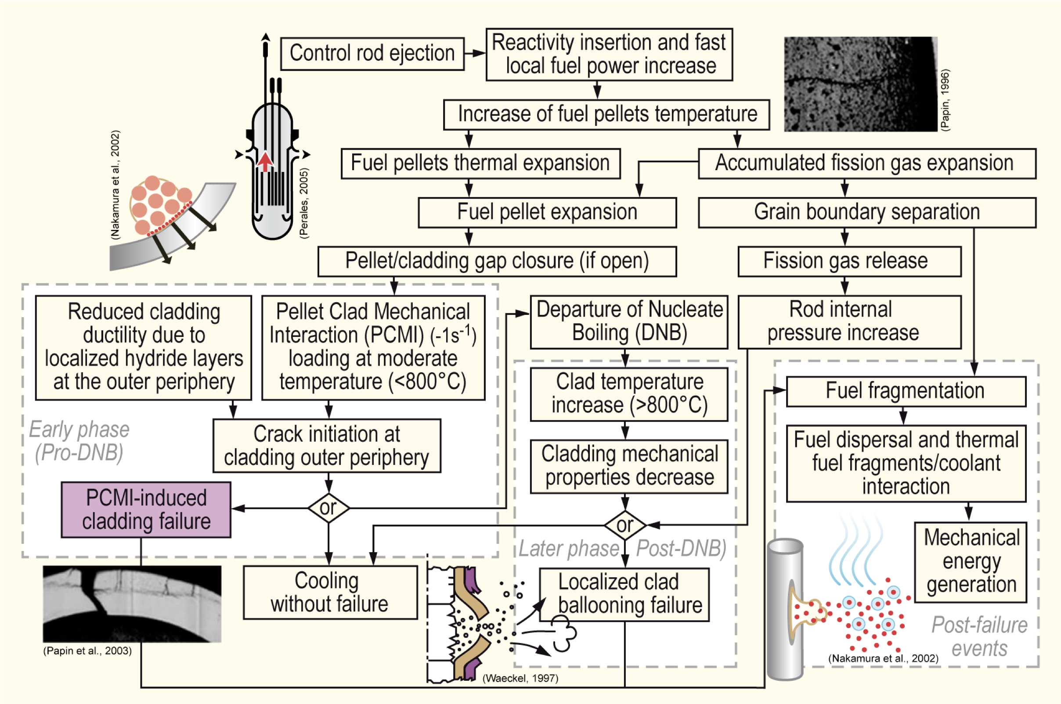
Sequence of RIA

Slide 13
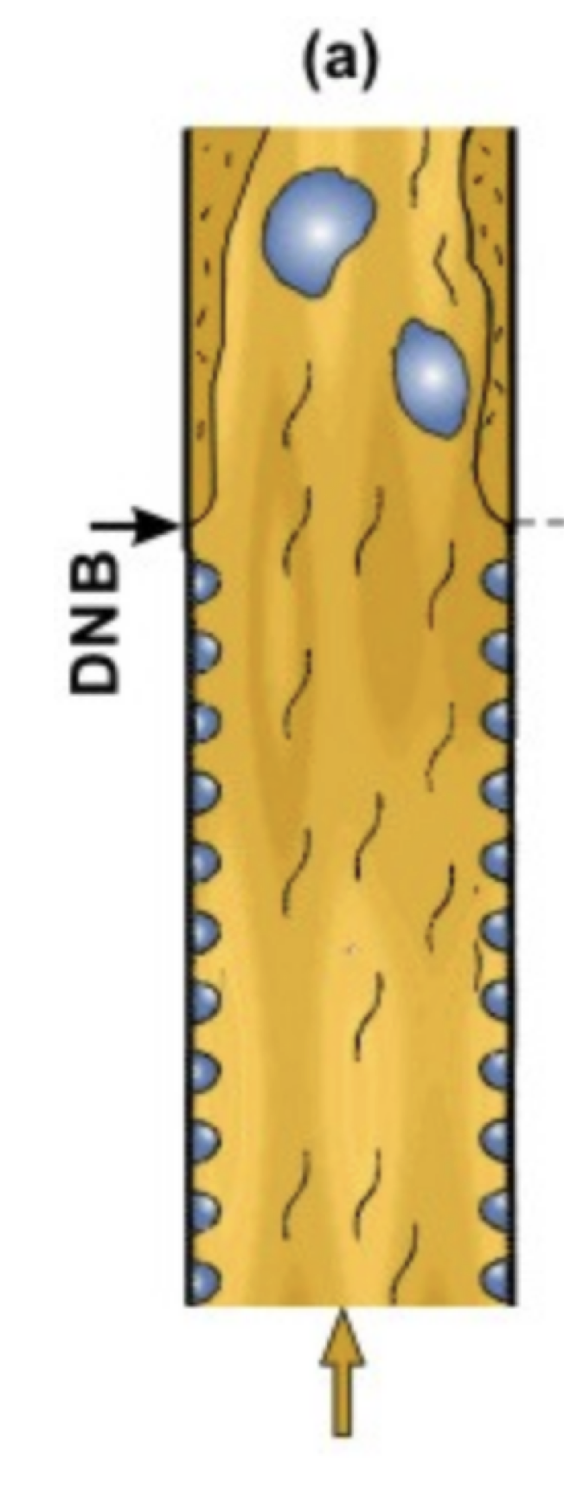
Departure from Nucleate Boiling
If the heat flux of a boiling system is higher than the critical heat flux (CHF) of the system, the bulk fluid may boil, or in some cases, regions of the bulk fluid may boil where the fluid travels in small channels
Large bubbles form, sometimes blocking the passage of the fluid
This results in a departure from nucleate boiling (DNB) in which steam bubbles no longer break away from the solid surface of the channel, bubbles dominate the channel or surface, and the heat flux dramatically decreases
Vapor essentially insulates the bulk liquid from the hot surface, increasing surface temperatures

Slide 14
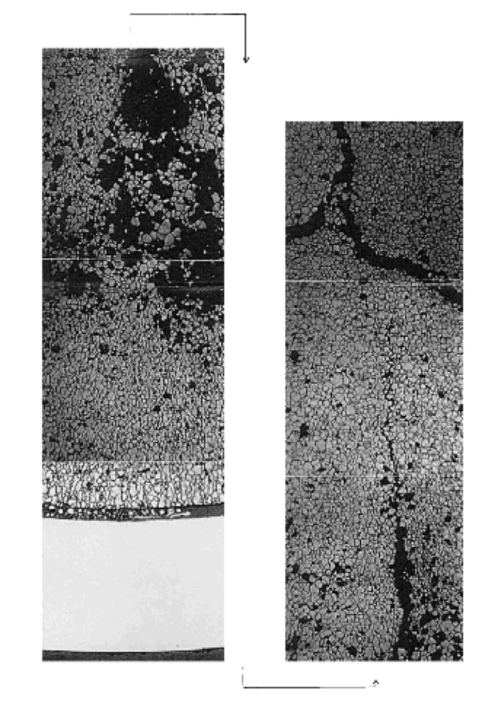
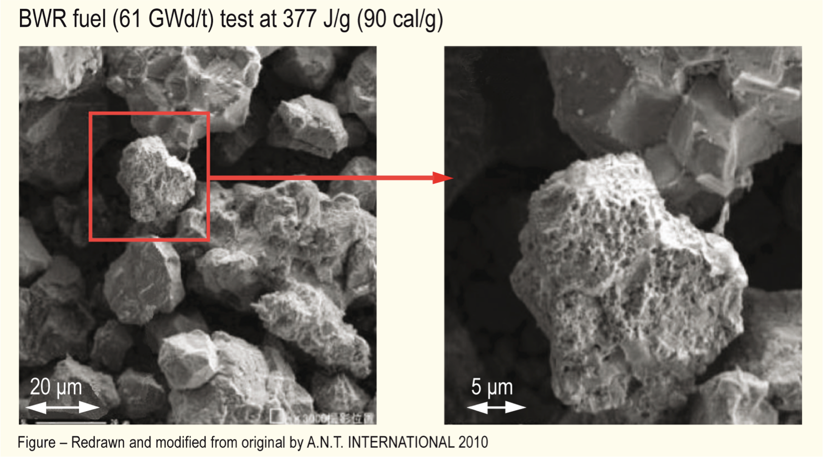
Microstructural Effects
Rapid increase in temperature increases pressure of bubbles
PV = nRT
Rapid pressure increase leads to cracking in fuel

Slide 15
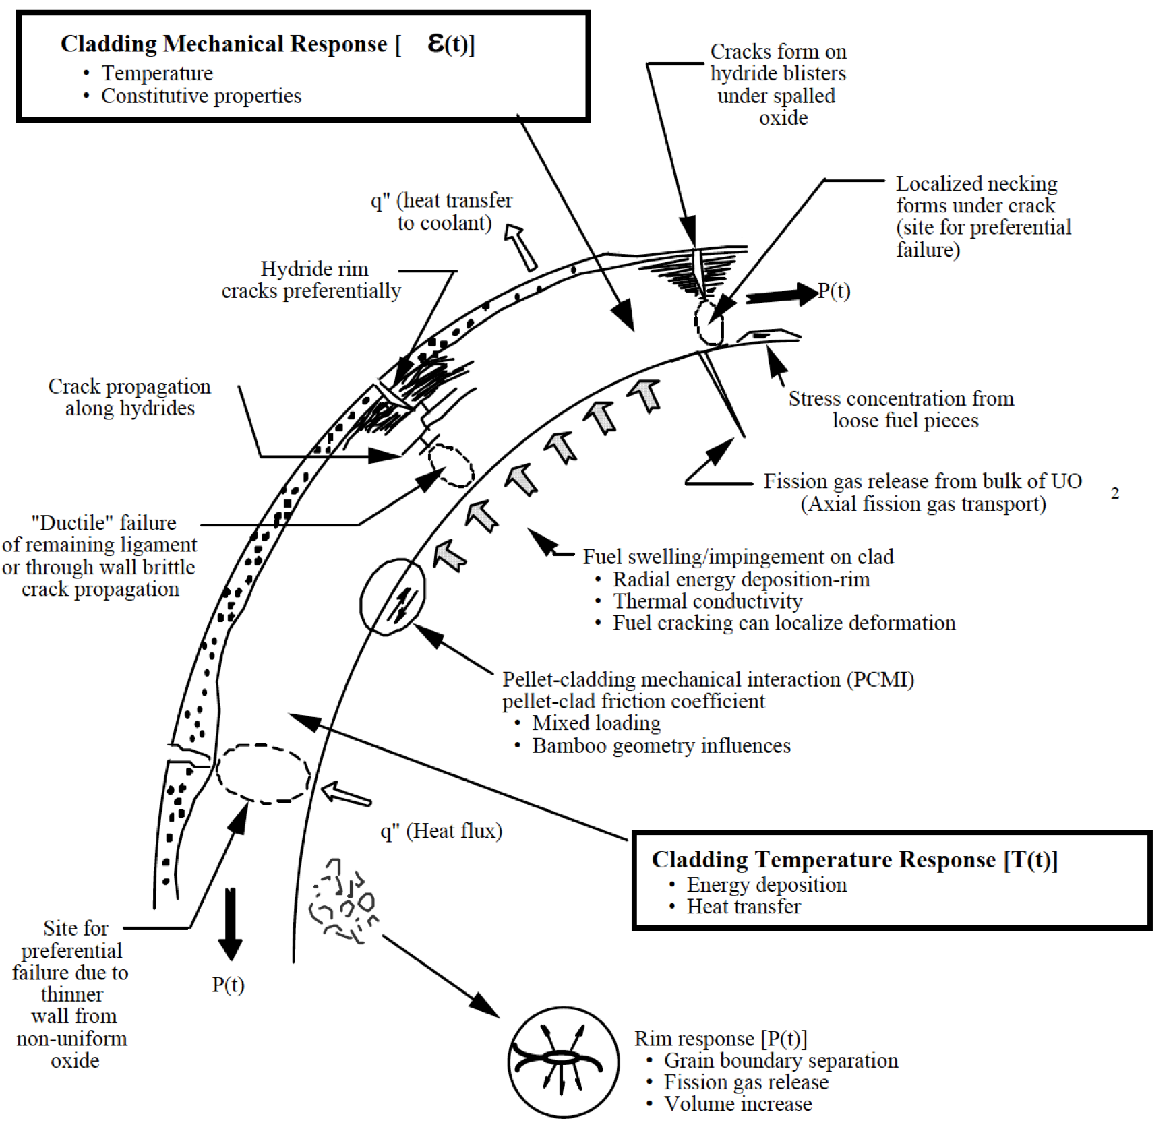
Cladding Response
Take into account burnup, corrosion (oxide layer and hydrides), damage accumulation, FCMI, internal pressure, etc. to properly evaluate strain in cladding
Temperature spike leads to a stress spike, and higher likelihood of cladding failure

Slide 16
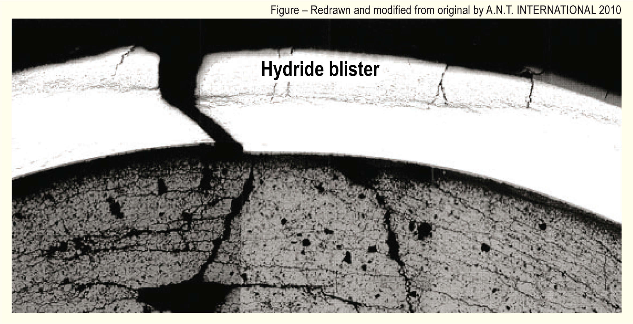
Cladding Response
PCMI failures results from the fuel pushing out on the cladding, causing it to break

Slide 17
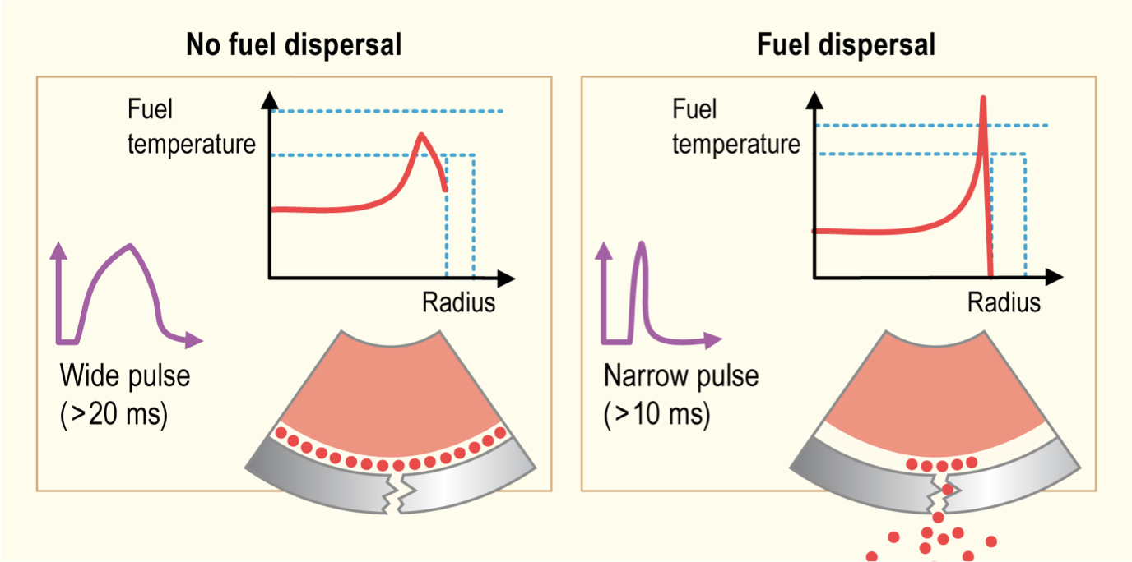
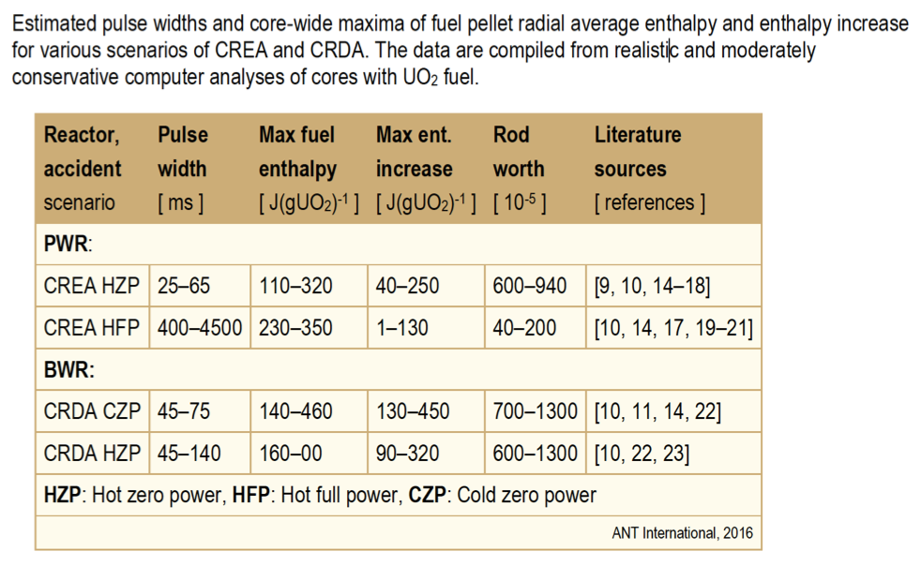
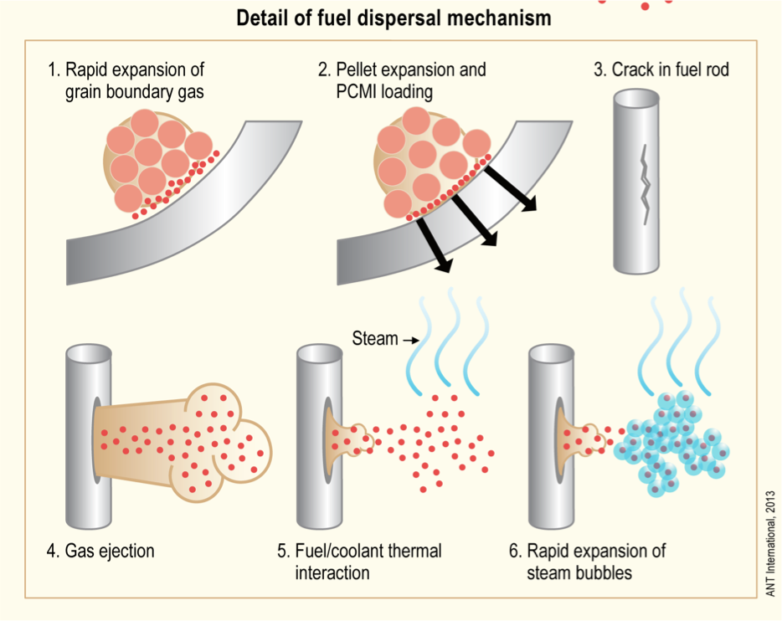
Pulse Width
The amplitude and width of the power pulse can have dramatic impacts on the effects of the RIA
Pulse is typically defined by FWHM, and by total energy deposition (integration of pulse)
More rapid temperature spike is more damaging
Reactor state and type during typical accident scenarios determine pulse width

Slide 18
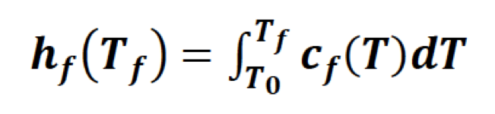
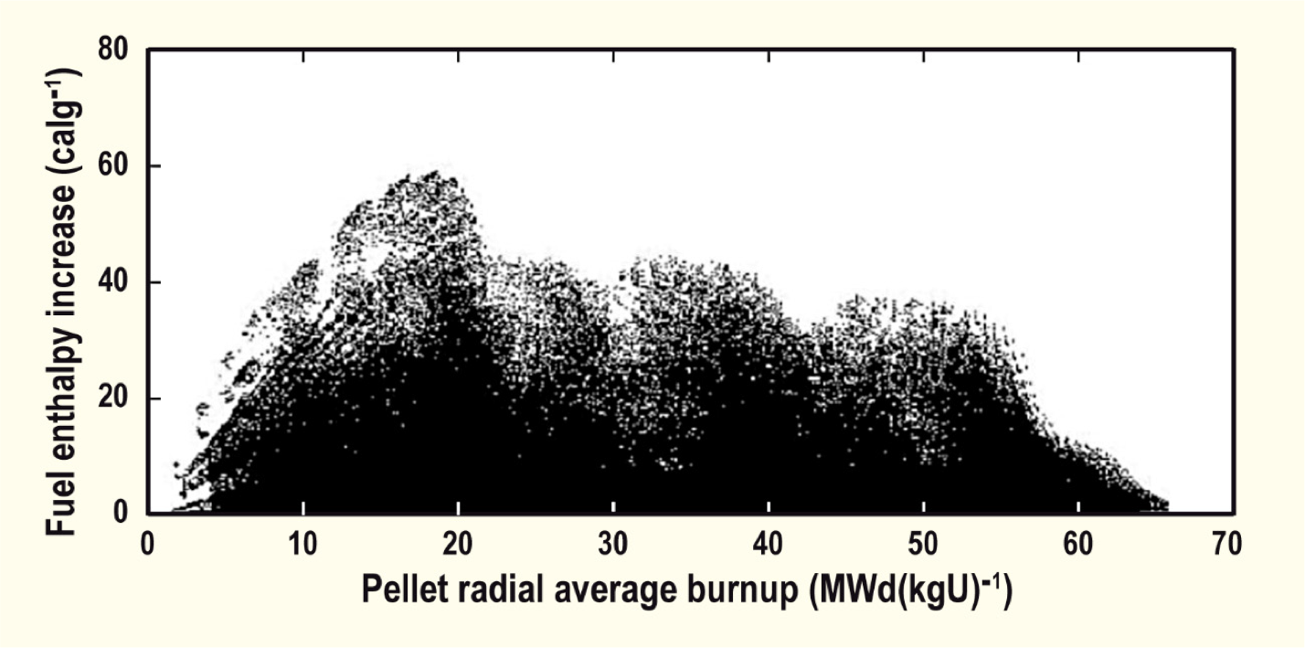
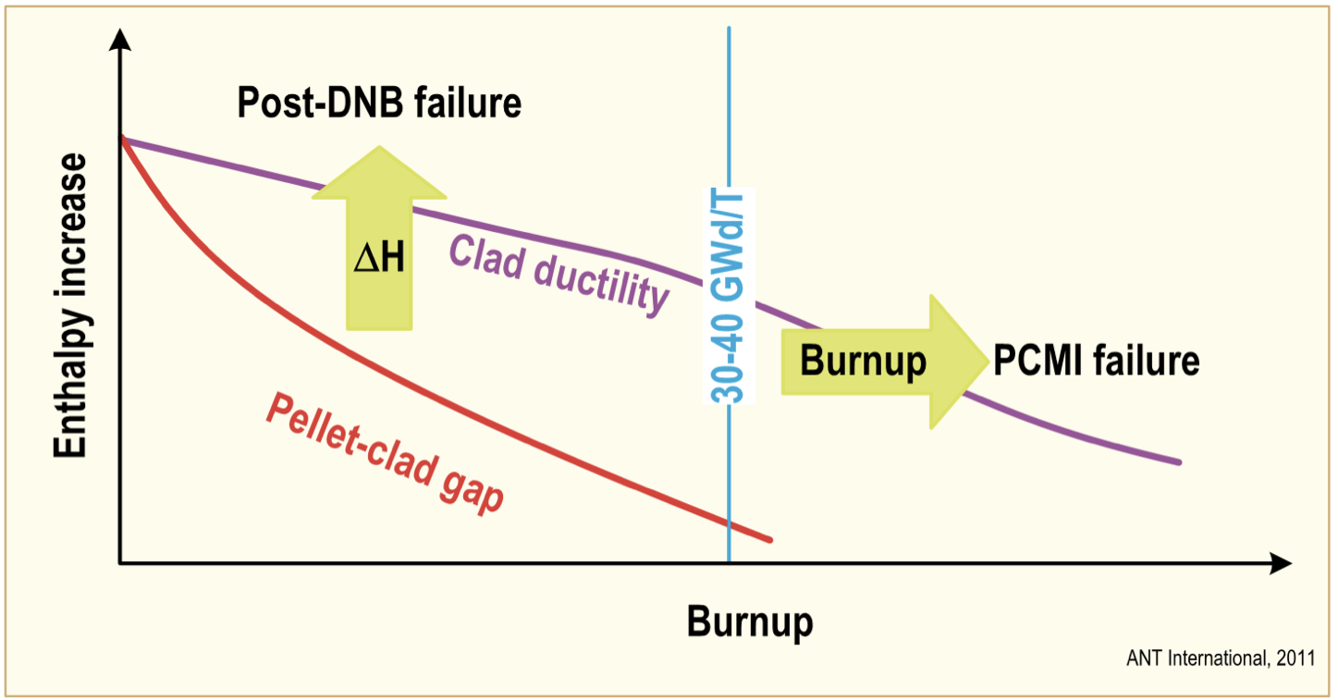
Effect of Burnup
Fuel rod damage correlates with the peak value of fuel pellet specific enthalpy; the higher the enthalpy, the more extensive is the damage
Cladding failure occurs at lower fuel enthalpies for irradiated than for fresh fuel rods, and that the susceptibility to failure increases with increasing fuel burnup
The degree of cladding waterside corrosion, is very important for survivability of preirradiated fuel rods
Safety criteria are defined in terms of limits on the radially averaged fuel pellet specific enthalpy, or the increase of this property during the accident

Slide 19
RIA Summary
Reactivity insertion accident
often in PWR/BWR dependent upon control rod ejection/drop
can be caused by changes in coolant
Shorter pulses have greater impact than longer pulses (given same energy deposition)
Effects of RIA depend on burnup
fission gas, FCMI, oxide layer, hydrides, cladding pressure, etc.

Slide 20
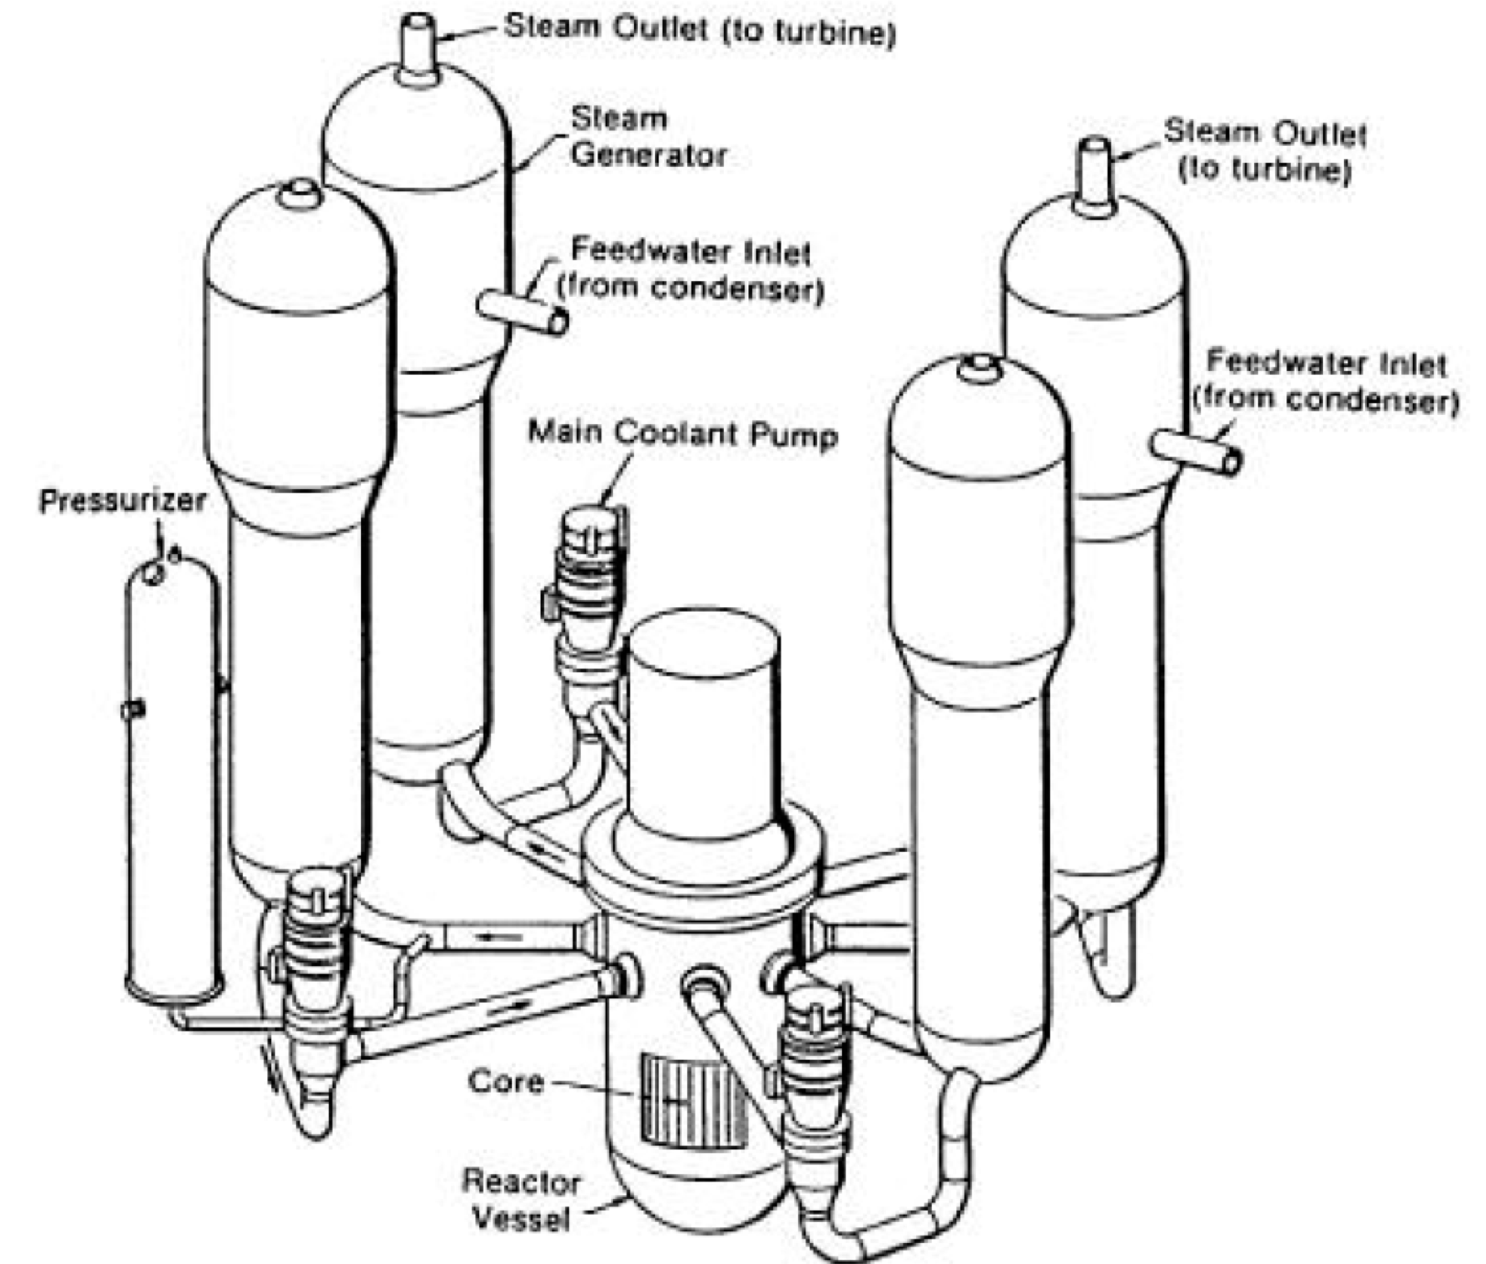
Loss of Coolant Accident (LOCA)
In a LOCA, the coolant flow is reduced or lost altogether (e.g. coolant pipe break)
When this occurs, pressure drops, causing the emergency shutdown system
SCRAMS the reactor, stopping the fission chain reaction
Also, the reactor water is expelled into the containment
The emergency core cooling system (ECCS) begins to remove heat
Requirement to maintain a coolable geometry

Slide 21
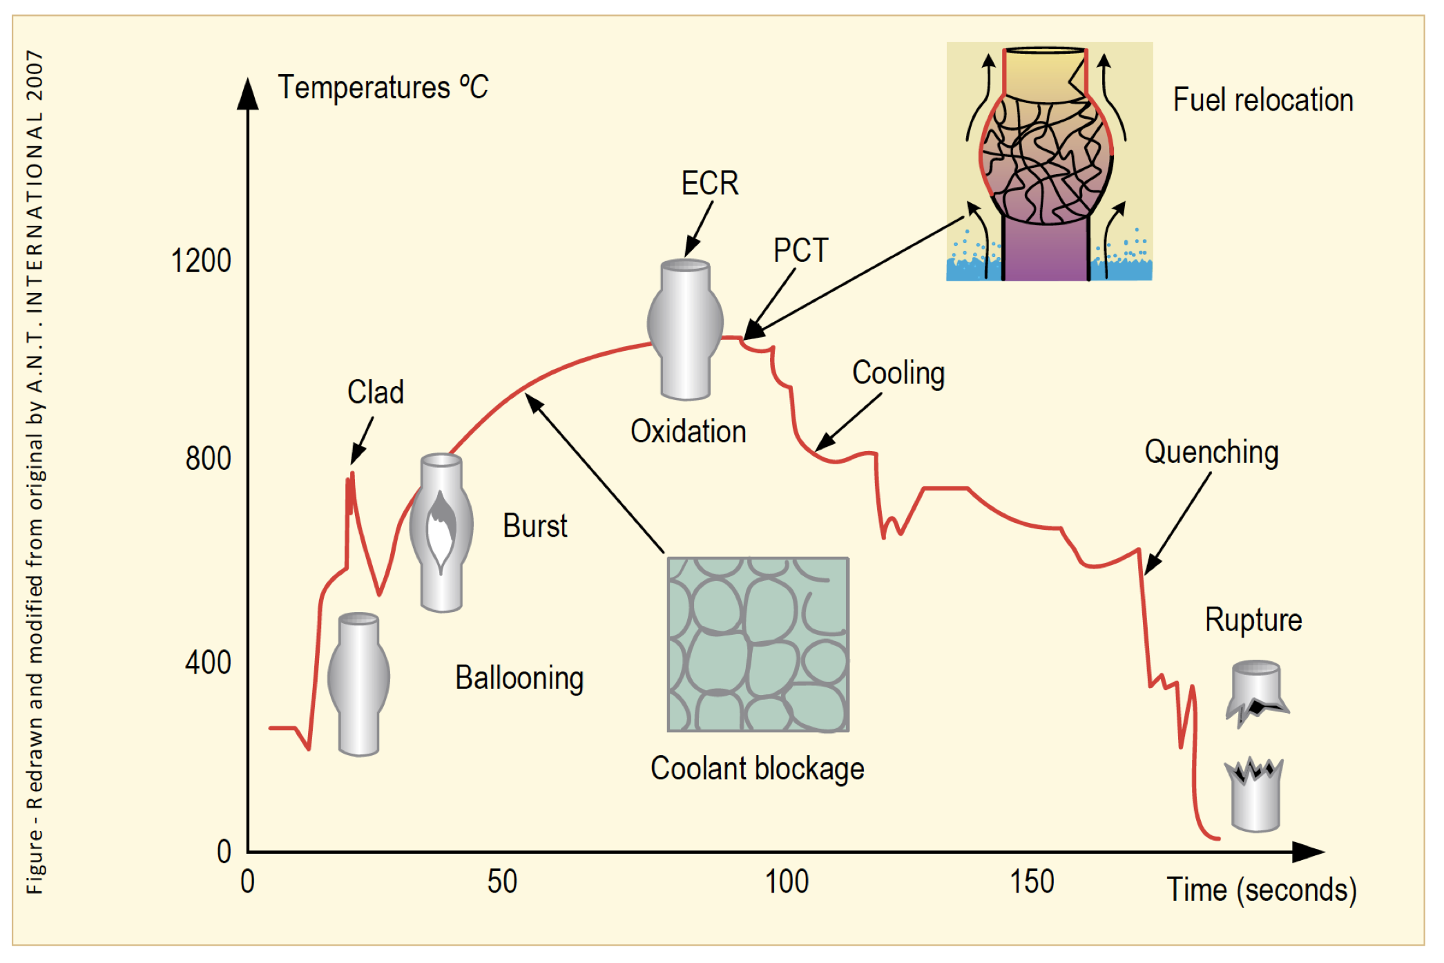
Loss of Coolant Accident (LOCA)
The average temperature of the reactor continues to rise due to radioactive decay in the fuel and the lower cooling
Decrease in coolant pressure and increase in internal pressure causes large plastic deformation
Causes the cladding to balloon out and potentially burst
Ballooning blocks coolant flow
Cladding burst is significantly impacted by oxidation and hydride embrittlement

Slide 22
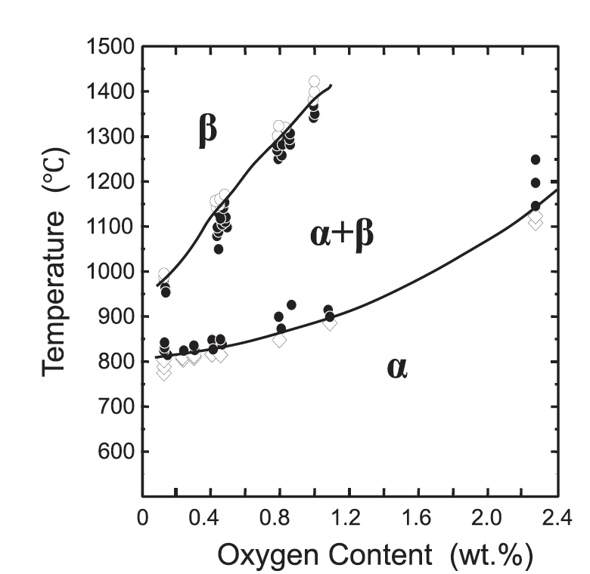
LOCA
During the heat-up, the cladding plastically deforms (balloon and rupture) due to decrease of the system pressure outside the fuel rod and decrease in cladding strength
The phase structure of Zircaloy transforms from alpha to alpha+beta above about 800C, and to beta above about 1000C
The cladding reacts with steam or coolant at high temperatures, and an oxide (ZrO2) layer is formed on the surface of the cladding
In addition, absorbed oxygen stabilizes the alpha-phase and a layer of alpha-phase with a high content of oxygen begins to grow on the beta-phase, and the beta-phase becomes less ductile by the oxygen absorption

Slide 23
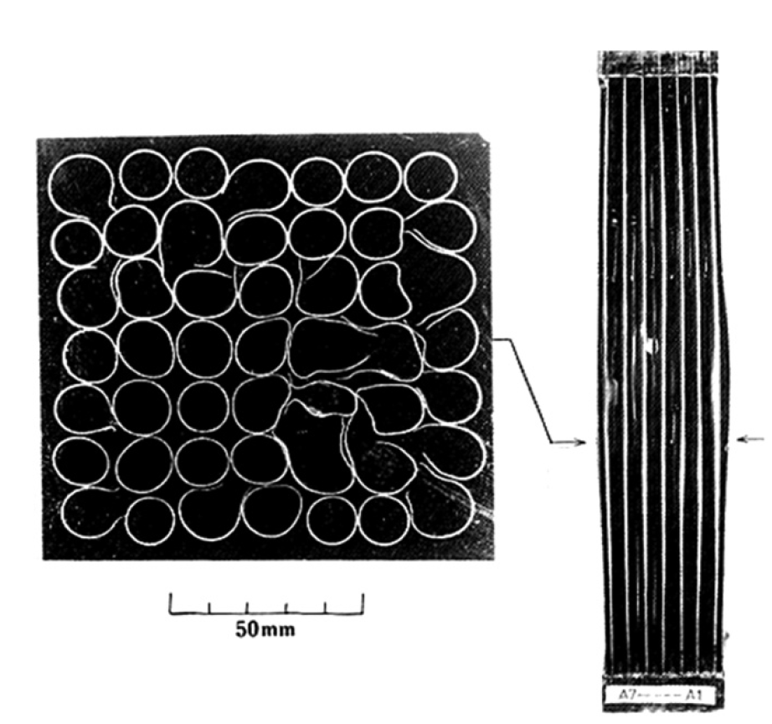
LOCA
The rod pressure becomes higher than the system pressure of the reactor due to a break of the coolant pressure boundary
Creep strength of Zircaloy rapidly falls with the temperature
The cladding plastically deforms in the radial direction (ballooning) during the heat-up and may finally rupture
The beta phase has different creep properties than the alpha phase, and alpha+beta phase can exhibit superplastic behavior
Large plastic deformation of the cladding in the radial direction results in blockage of the coolant channels between fuel rods

Slide 24
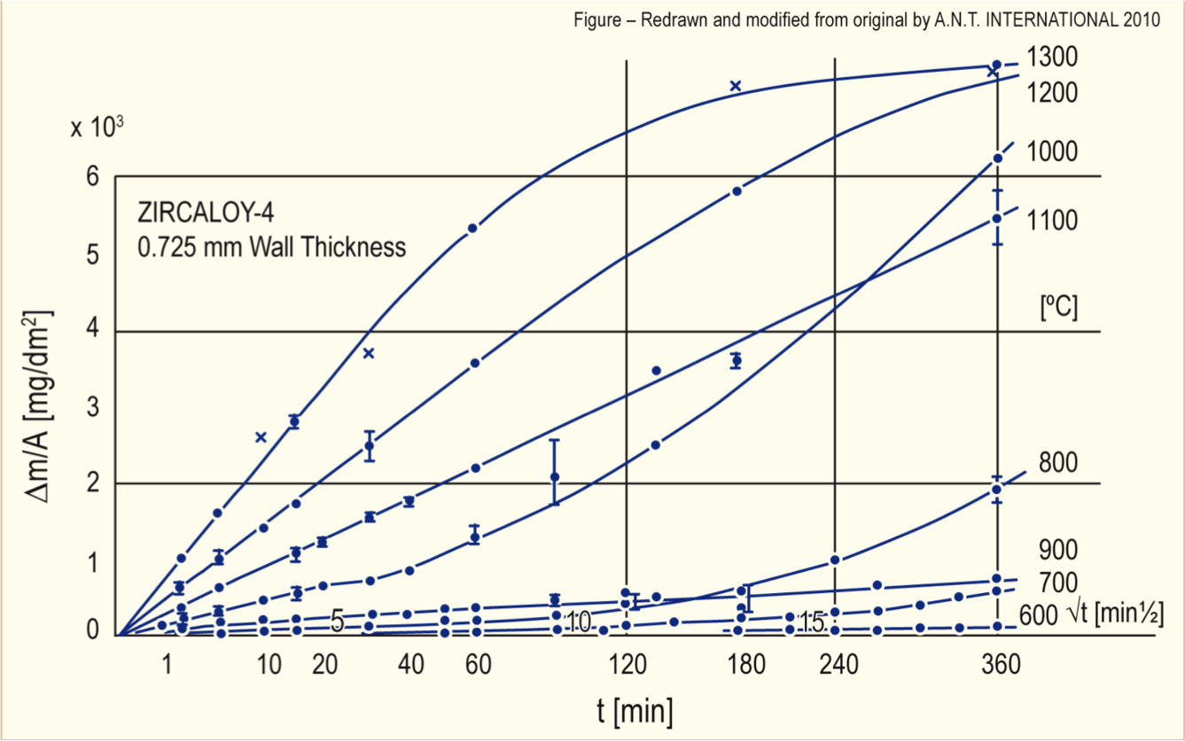
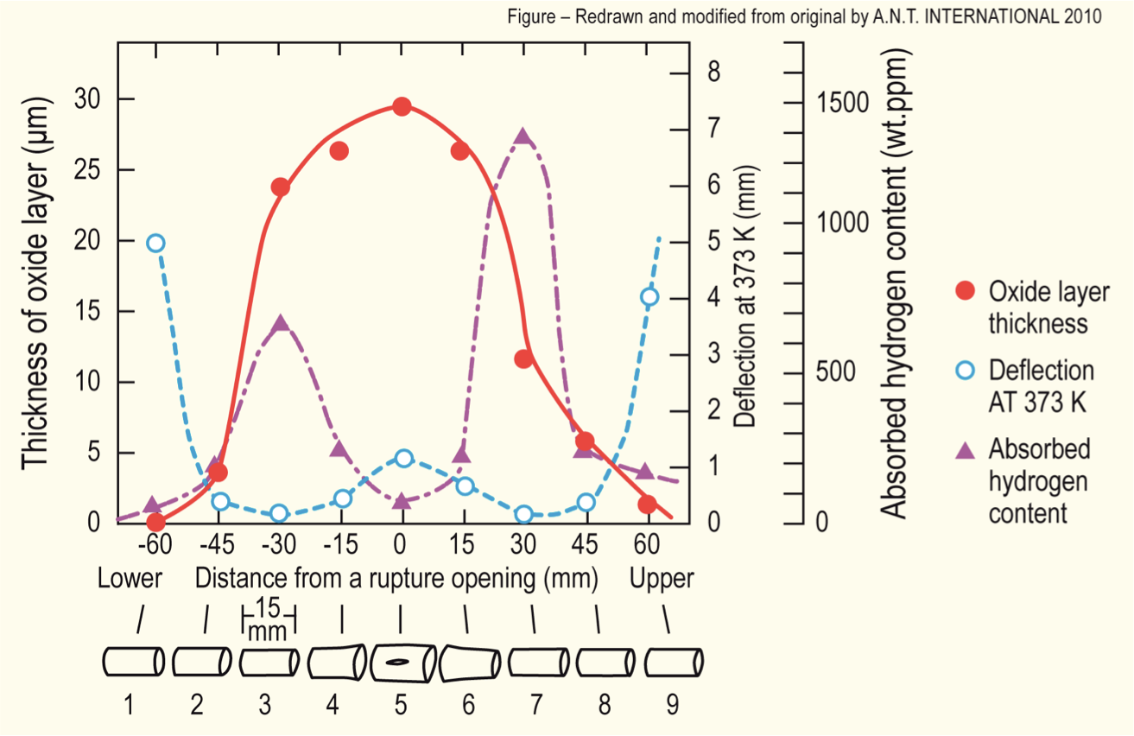
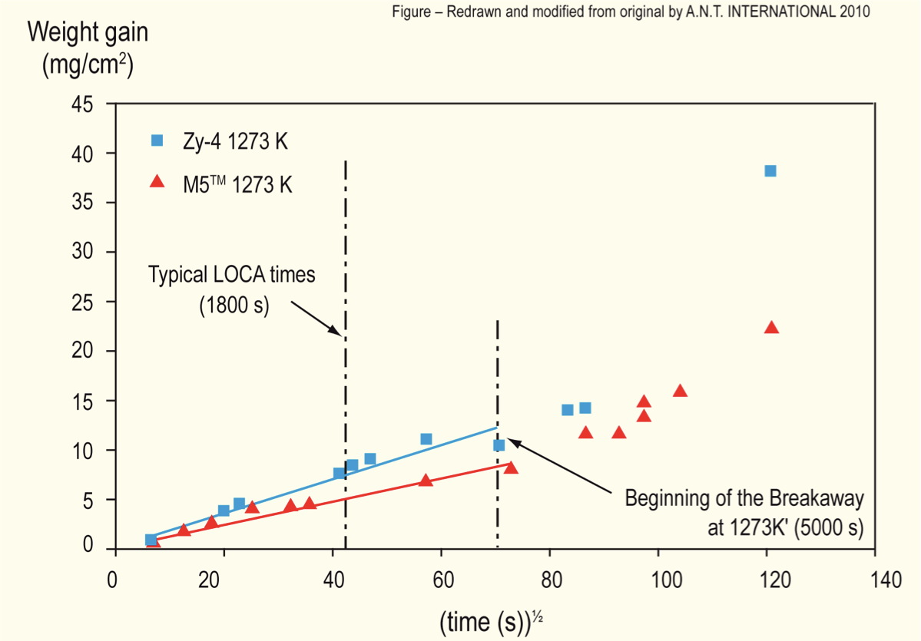
Oxidation
Oxidation significantly increases at high temperatures
Due to exothermic heat generated during oxidation of the cladding, at high enough temperatures, the rate of oxidation is so high that the heat can no longer be dissipated by cooling, leading to run-away oxidation (Three Mile Island)
Breakaway oxidation also results in increased hydrogen pickup in the cladding, embrittling cladding

Slide 25
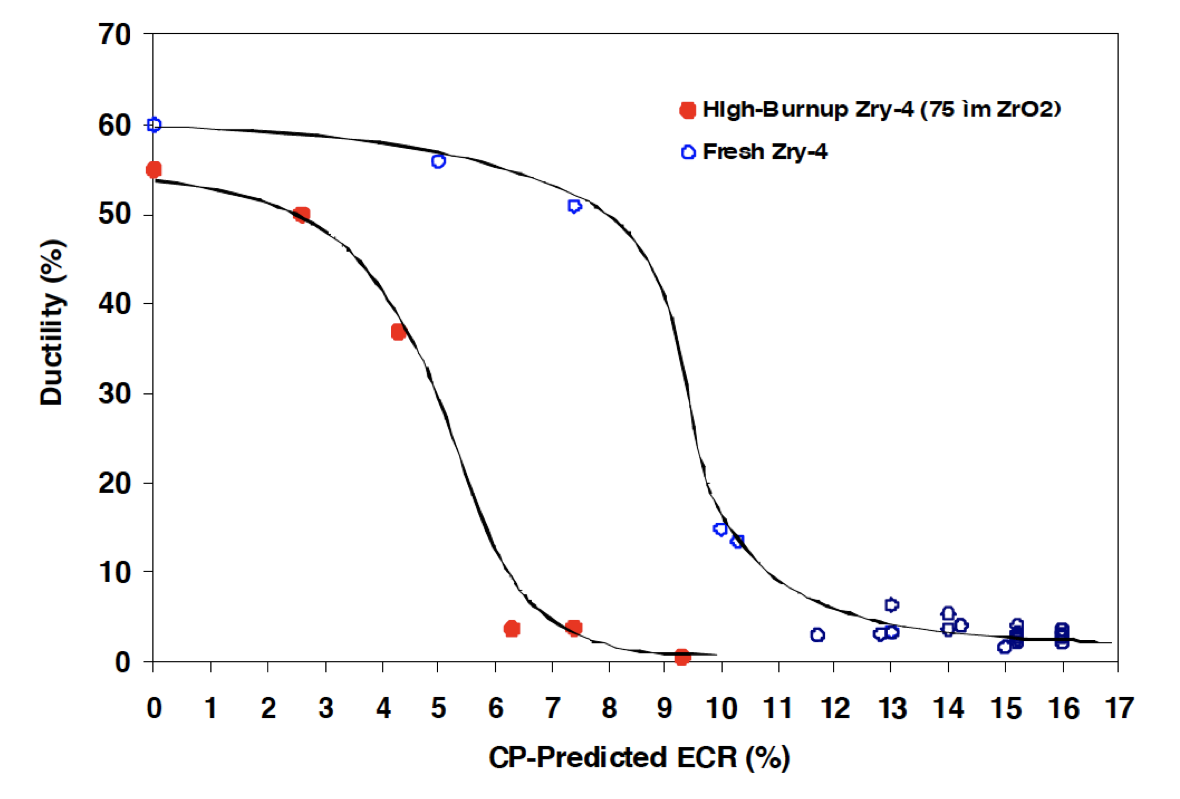
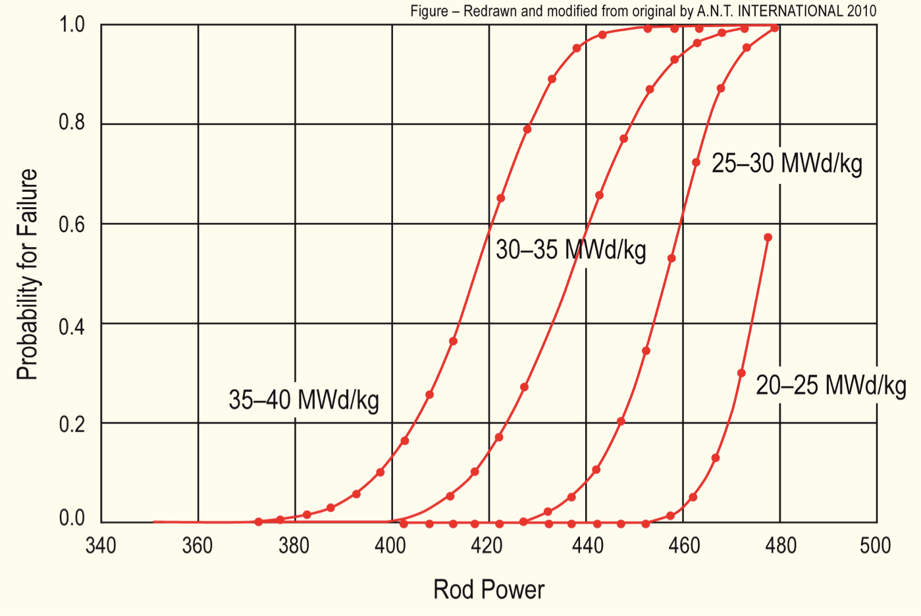
Effect of Burnup
At high burnup, ductility of the cladding is significantly reduced due to existing corrosion and hydrogen embrittlement
This leads to higher likelihood of failure for higher burnup conditions
Similar to RIA (but more slow), temperature increases can lead to gas bubble pressure increases, fuel fragmentation, increased thermal expansion, FCMI, etc.

Slide 26
Mitigation through design
Accident tolerant fuels aim to provide additional coping time
The time required for the water to boil away
The time required for the fuel to melt
The time required for the molten fuel to breach the primary pressure boundary
Fuels with enhanced tolerance can tolerate loss of active cooling for a considerably longer period, while maintaining or improving performance during normal operation

Slide 27
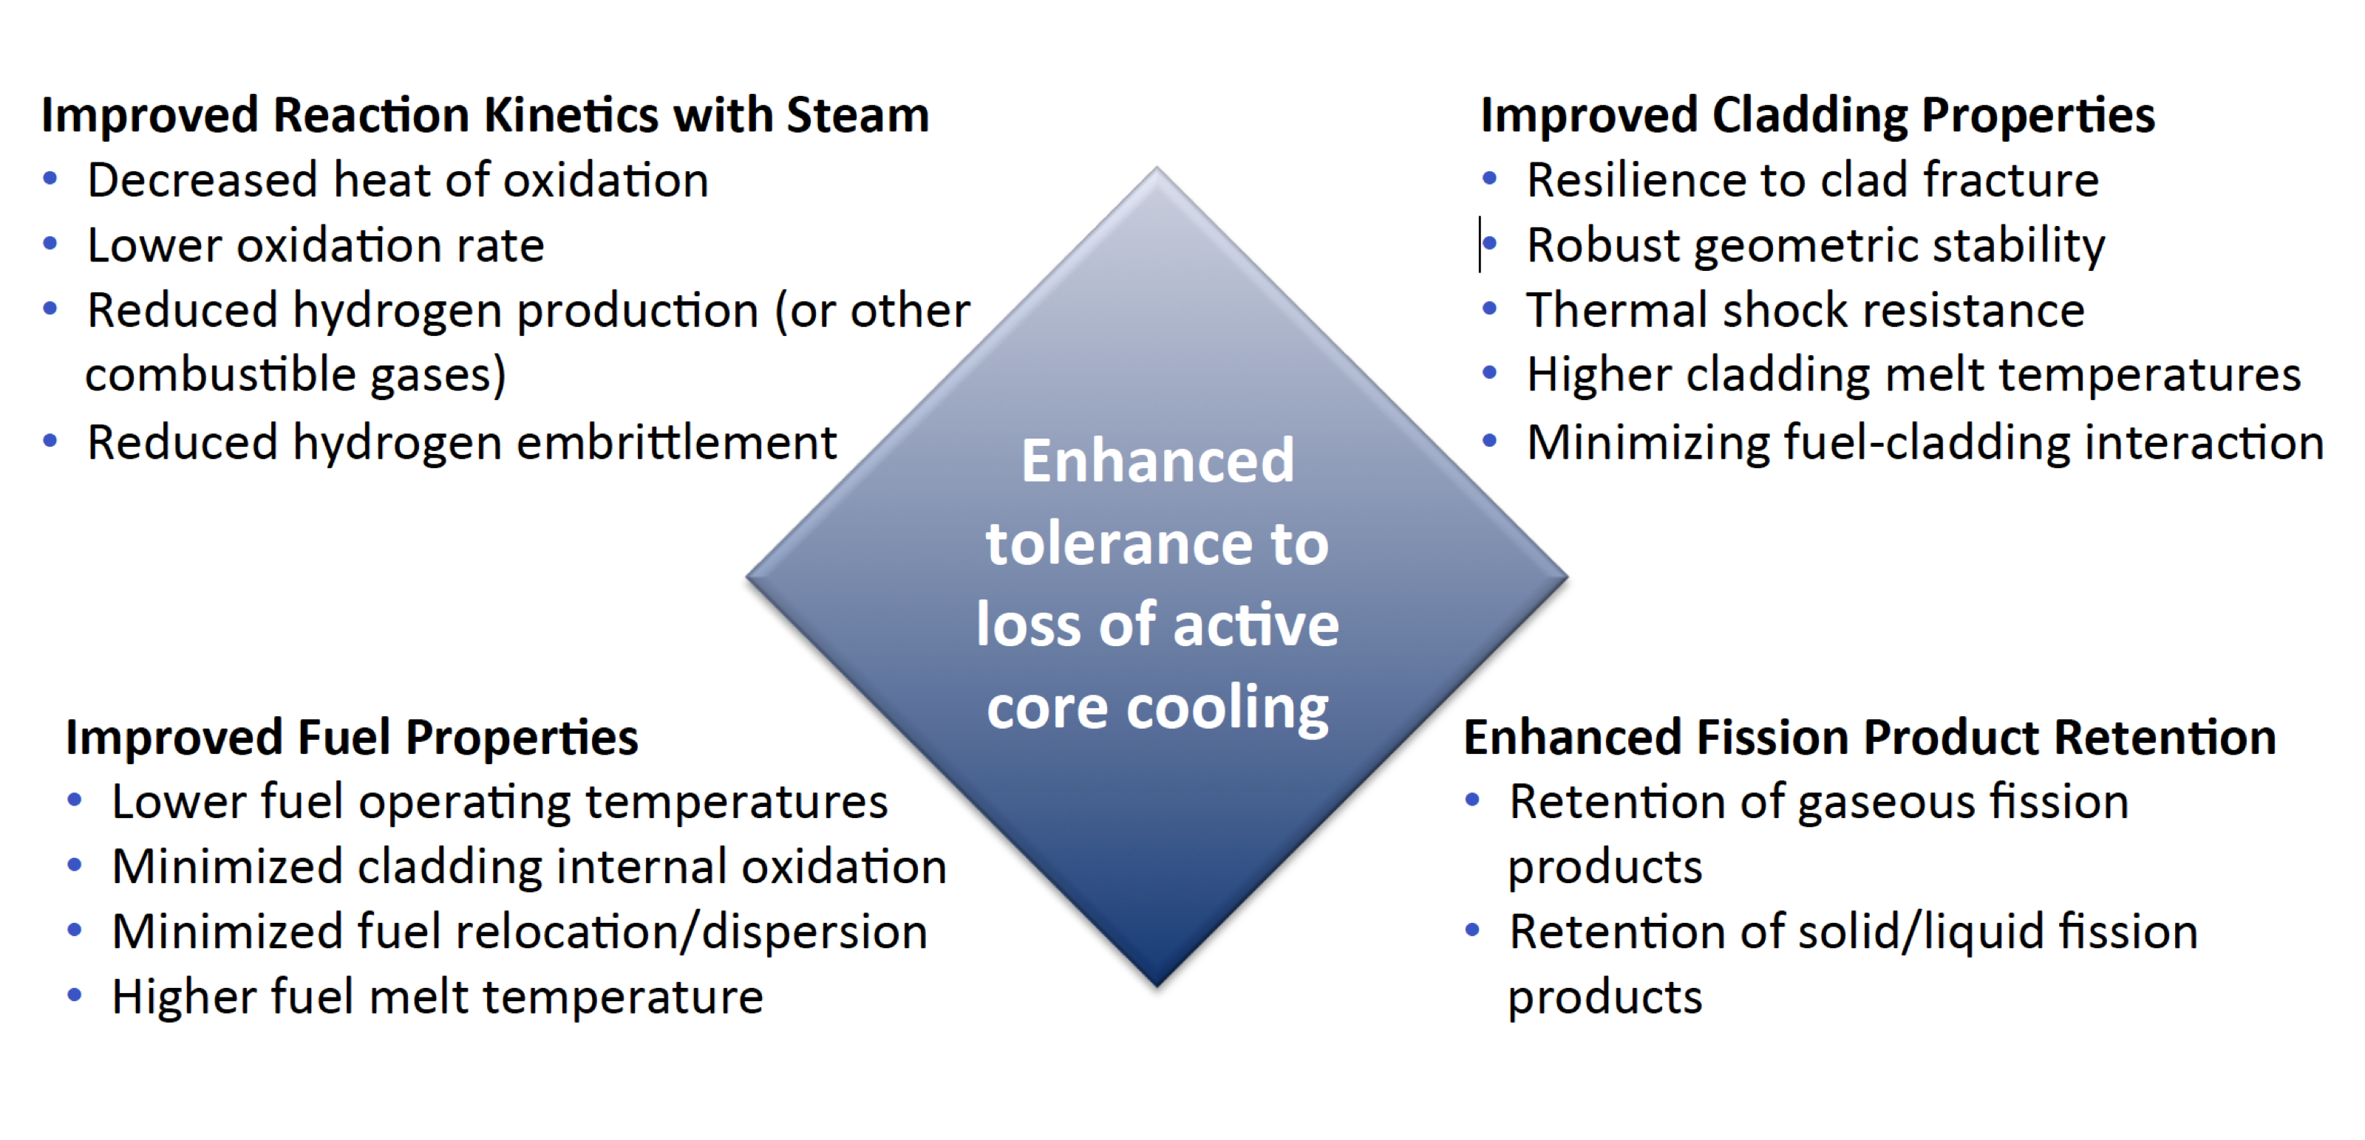
Accident Tolerance

Slide 28
ATF options being pursued
Cladding coatings/liners
protect the Zircaloy from steam: Ti3SiC2, etc.
Alternate claddings
SiC, FeCrAl, refractory alloys
UO2 dopants
Cr, SiC, BeO, etc.
Alternate fuels
USi, UN, UC, microencapsulated fuel

Slide 29
Summary
In loss of coolant accidents (LOCA), the fuel and cladding experience
increases temperature
decrease in coolant pressure
The primary negative effects are
Embrittlement and ballooning of the cladding
Relocation and fission gas release in the fuel
Cladding can burst and release fuel fragments
Accident tolerant fuel includes different fuel and cladding materials to increase time before catastrophic behavior during an accident

Slide 30
Limiting Phenomena
Concerning limiting phenomena, some criteria have been established for the UO2 and MOX fuel designs
Engineering must demonstrate that all relevant parameters fulfil those criteria at any time from the loading of the fuel to reprocessing, or during long-term storage
The key performance limiting phenomena are: Pellet-clad mechanical interaction; Cladding elongation and assembly bow; Cladding oxidation and hydrogen pickup; Cladding wear; Power to melt; Fuel rod internal pressure; Departure from nucleate boiling; Normal operation limits

Slide 31
Limiting Phenomena
PCMI
PCMI is a complex process with a maximum risk for failure when the fuel pellet to cladding gap closes firmly and the reactivity of the fuel is still high
The risk is enhanced by pellet fragments inducing a local shear strain on the cladding, and by the chemical interaction kinetic at the interface
In order to prevent SCC, the cladding hoop stress calculated for normal operation and transients is limited
The extent of the total permanent hoop strain is limited during the whole lifetime of the fuel rods, typically to 1%

Slide 32
Limiting Phenomena
Cladding elongation and assembly bow
During irradiation, the anisotropic character of the cladding material and the preferential migration of vacancies and interstitials in specific lattice planes drive an overall cladding axial growth, activated by the fast neutron flux
When contact is established between the pellet and the cladding, pellet axial elongation causes an additional axial cladding strain
This can lead to fuel rod bow with pitch reduction between the rods, reducing thermal margins
Differential elongation of guide tubes in a PWR assembly can lead to an overall assembly bow

Slide 33
Limiting Phenomena
Cladding oxidation and hydrogen pickup
For the ZrO2 formation at the cladding waterside surface, a typical criterion is related to the ASTM criterion of a maximum cladding wall thickness reduction of 10%, which corresponds to an oxide thickness of the order of 100 microns
When the hydrogen concentration in the cladding exceeds the solubility limit, 70–100 ppm by weight at operating temperatures, zirconium hydrides will form
The impact of hydrides on key mechanical properties depends strongly on hydride distribution and orientation
Oxidation and hydrogen pickup are increasingly important at higher exposures, as the dependence on burnup is nonlinear

Slide 34
Limiting Phenomena
Cladding wear
The criterion for cladding wear at the contact points between grid spring/dimples and the fuel rod is often also related to the ASTM criterion of a maximum cladding wall thickness reduction of 10%
More wear is technically acceptable, as evidenced from operational experience

Slide 35
Limiting Phenomena
Power to melt
The use of uranium dioxide or MOX provides a comfortable power to melt margin
The melting temperature decreases slightly with burnup, but remains above 2750C
At high burnup, above 50 MWd/kgM, considering the fuel thermal conductivity decrease, the power to melt was estimated to be around 600 W/cm, which is an unrealistic high LHR

Slide 36
Limiting Phenomena
Fuel rod internal pressure
Significant reopening of the radial gap between the fuel stack and the cladding must be avoided to ensure at the heat transfer to the coolant
If a gap opens, fuel overheating and excessive fission gas release can occur, ultimately leading to fuel failure
The original criterion required that the rod inner pressure must never exceed the outer coolant pressure
This criterion was over-conservative and has been replaced by a ‘nonlift-off’ criterion, where the radial creep-out of the cladding (driven by gas pressure in excess of the system pressure) must never exceed the expansion rate of the pellet
Experiments have shown that a large overpressure of the gas (considerably more than 5.0 MPa) is needed to initiate the reopening

Slide 37
Limiting Phenomena
Departure from nucleate boiling
With increasing heat flux there comes a point at which the heat transfer from a fuel rod rapidly decreases due to the insulating effect of a steam blanket that forms on the rod surface, resulting in a severe increase of cladding temperature and possibly cladding failure
The ratio of the heat flux needed to cause departure from nucleate boiling (DNB) at given local coolant properties (pressure, enthalpy, mass flow rate) to the actual local heat flux of a fuel rod is defined as the DNBR
This phenomenon may limit the maximum allowed thermal power of a given PWR

Slide 38
Limiting Phenomena
Normal operation limits
Constraints on the axial LHR distribution are typically applied at the core design level and during normal operation to guarantee that the conditions are never worse than those assumed in scenarios considered in the accident analyses
The maximum allowed LHR may depend on the axial position and on burnup, and can be reactor- and even cycle-specific
The fulfilment of the constraint is verified during the reload safety evaluation process as well as during plant operation

Slide 39
Summary
There are a variety of limiting phenomena in LWR fuel systems that provide the boundaries of operation and lifetime
These limits include phenomena in the fuel, gap, cladding, corrosion, and assembly levels
The performance of uranium dioxide and MOX fuels in LWR nuclear reactors is well established
These fuels have demonstrated a very good behavior during irradiation, favored by their high melting temperature, providing large operating temperature margins

